Slide 1
Engineering Parametrics
Parametric analysis for engineered systems
William D. O’Neil
Analysis for Decision
March 2010

Slide 2
System parameters
Independent variables
Some set by designer, others by operator
Design parameters collectively define design
Operational parameters collectively define operational state or condition
Operational parameters limited by design
Have meaning only relative to system model

Slide 3
Parametric analysis
Interplay between theory and sensible data
Empirical estimation/validation of parameters
Parameter effects on dependent variables
Synthesis and validation of model
Analysis of regularities and patterns among members of class of parameters
Reference: Walter G. Vincenti, What Engineers Know and How They Know It: Analytical Studies From Aeronautical History (Baltimore: Johns Hopkins University Press, 1990), pp. 139-66 passim.

Slide 4
History outline
Used by Greek & Roman engineers
Renaissance artillerists
Refined by John Smeaton in 1750s
Graphical methods c.1800-c.1980
Dimensional analysis from c.1880
Subsumed in computer modeling from c.1980

Slide 5
Historical case: Waterwheels
Predominant industrial power source before mid 1800s
~2,000 years craft-tradition engineering — very slow improvement
>100,000 waterwheels by 1700
Rational mechanical theory by A. Parent, early 1700s
Parametric analysis of model and full-scale tests by John Smeaton showed defects in theory and provided sound design basis — published 1759
Revised theory published 1767 by J.C. Borda — not well accepted until 1830s
Parametric analysis of data remained important in design until end of waterwheel era in early 1900s
Reference: Terry S. Reynolds, Stronger Than a Hundred Men: A History of the Vertical Water Wheel (Baltimore: Johns Hopkins University Press, 1983).

Slide 6
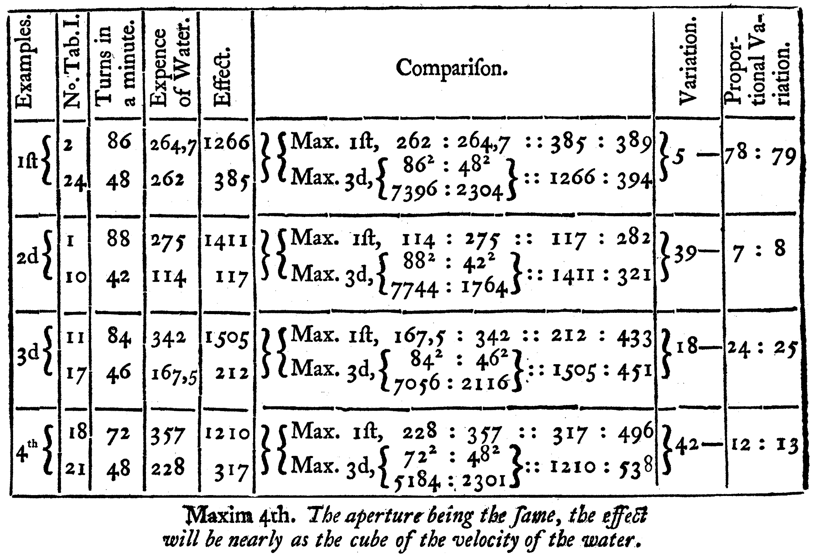
Smeaton’s analysis
John Smeaton, “An Experimental Enquiry Concerning the Natural Powers of Water and Wind to Turn Mills, and Other Machines, Depending on a Circular Motion,” Philosophical Transactions 51 (1759): 100-74, pp. 119-20.

Slide 7
Simple real-world examples

Slide 8
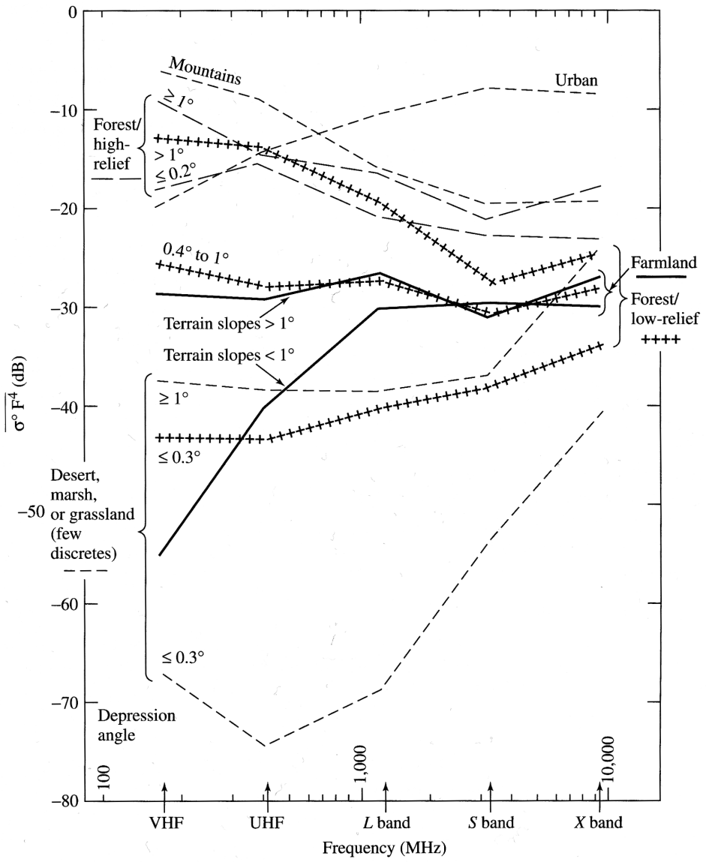
Radar land clutter
Merrill I. Skolnik, Introduction to Radar Systems, Third ed. (Boston: McGraw-Hill, 2001), p. 411.

Slide 9
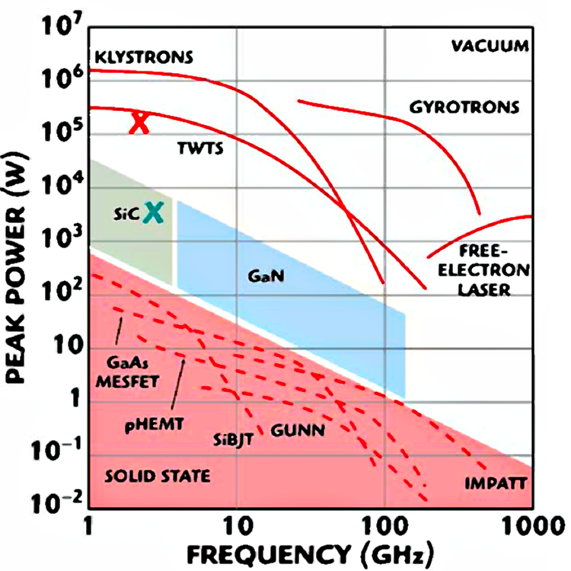
Electron devices above 1GHz
Eli Brookner, “Now: Phased-array Radars: Past, Astounding Break-throughs and Future Trends,” Microwave J. 51, no. 1 (2008): 30.

Slide 10
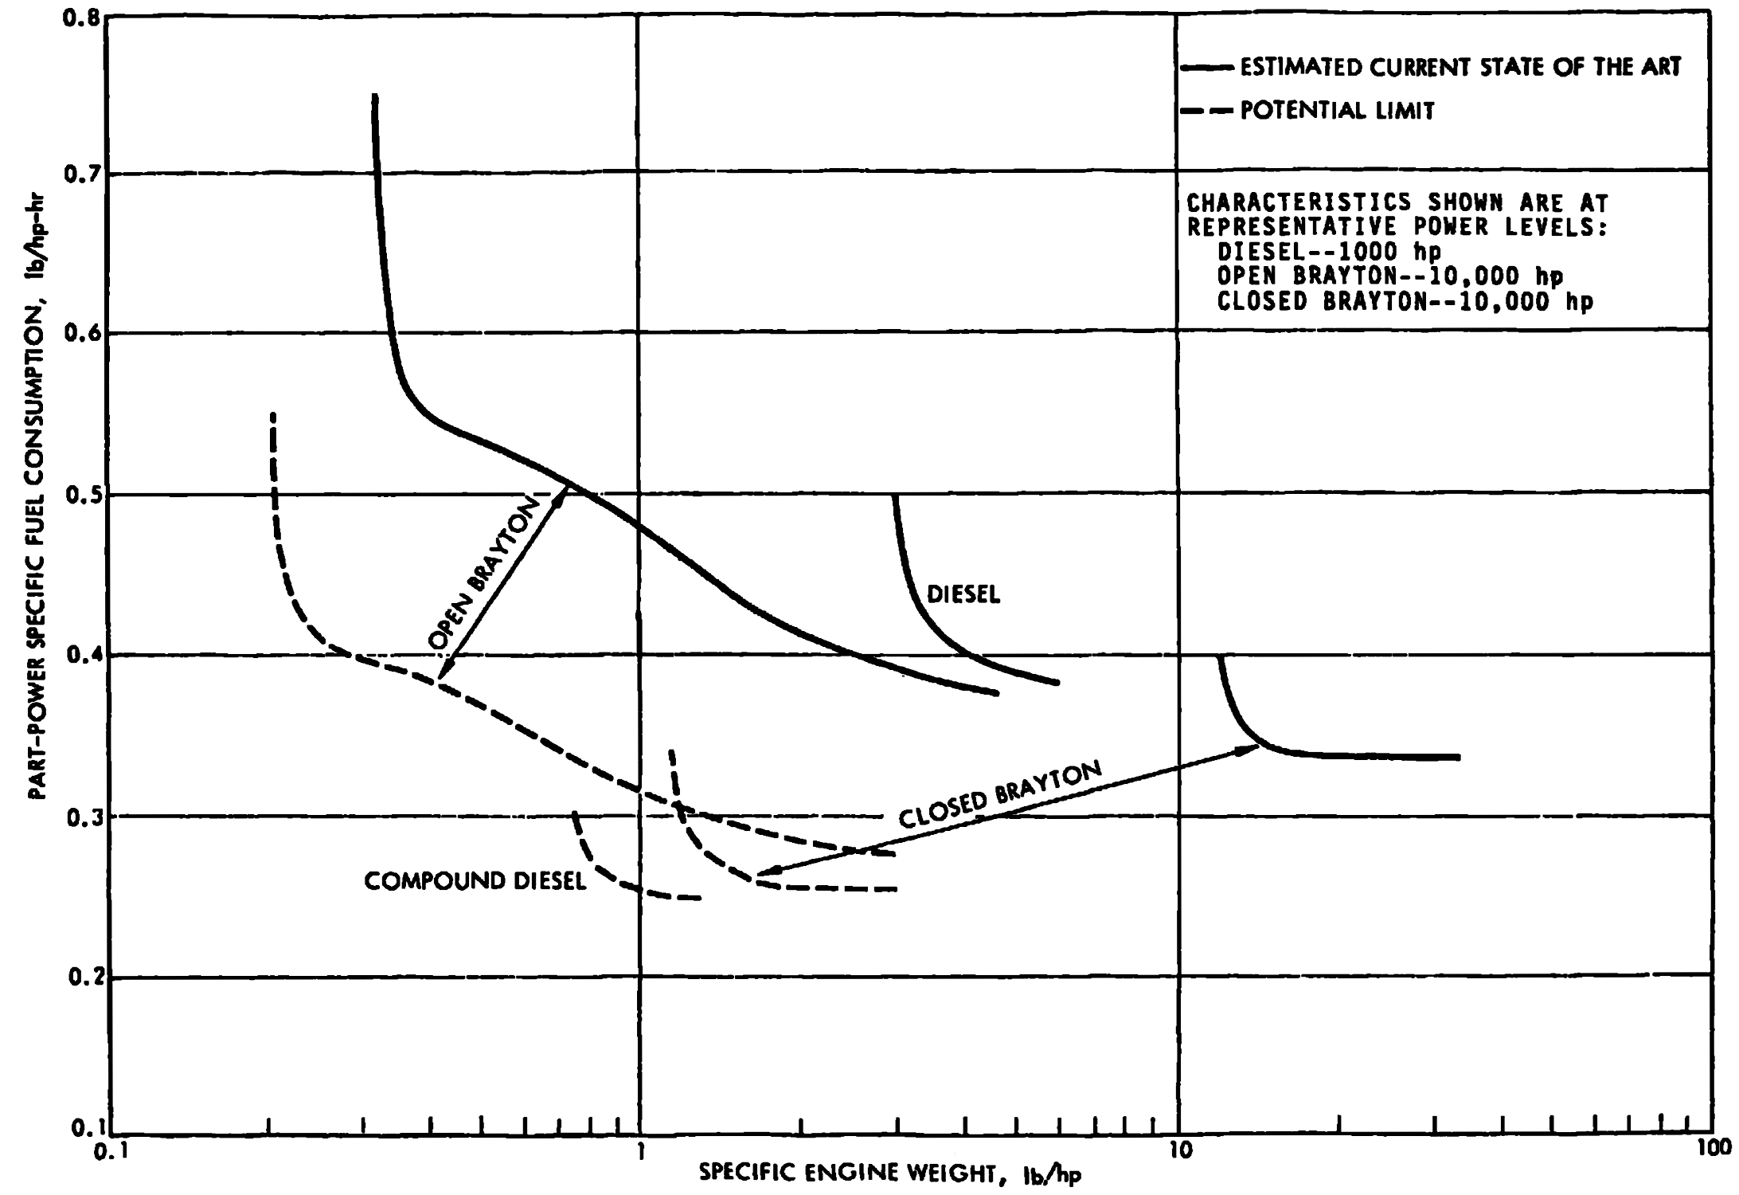
Engine limits (1978)
Fred R. Riddell and Donald M. Dix, “Technology Assessment of Advanced Propulsion Systems for Some Classes of Combat Vehicles,” P-1278 (Arlington: Institute for Defense Analyses, 1978), p. 84.

Slide 11
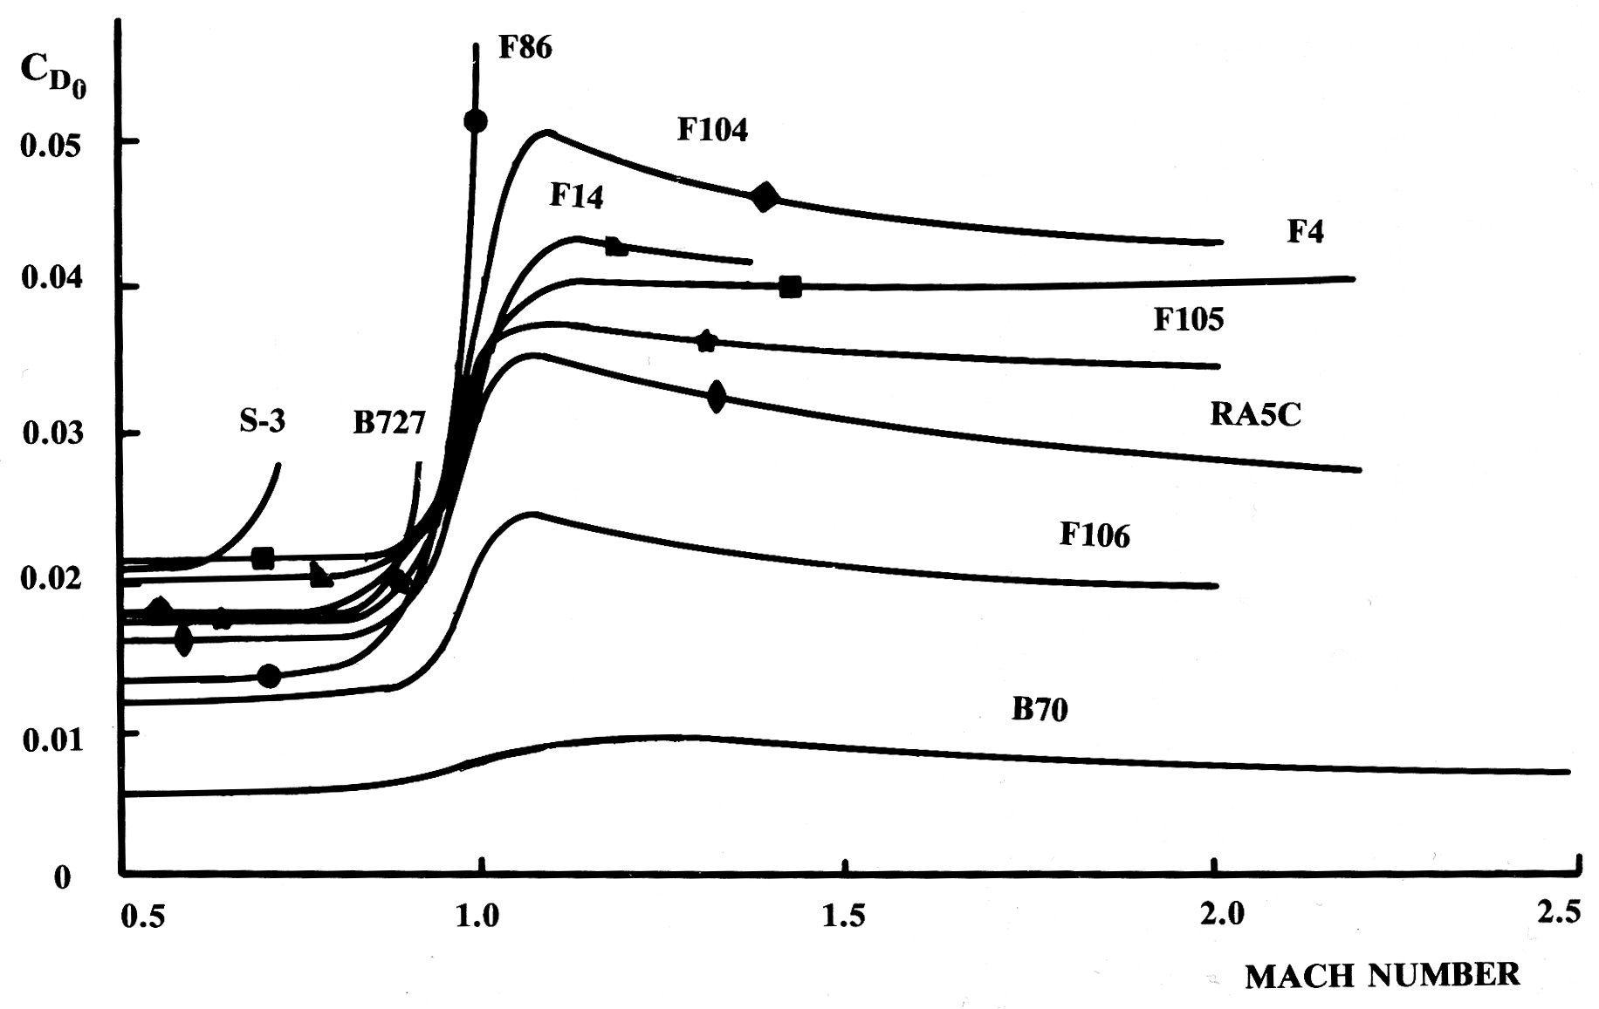
Jet fighter profile drag
Daniel P. Raymer, Aircraft Design: A Conceptual Approach (Washington: AIAA, 1989), p. 296.

Slide 12
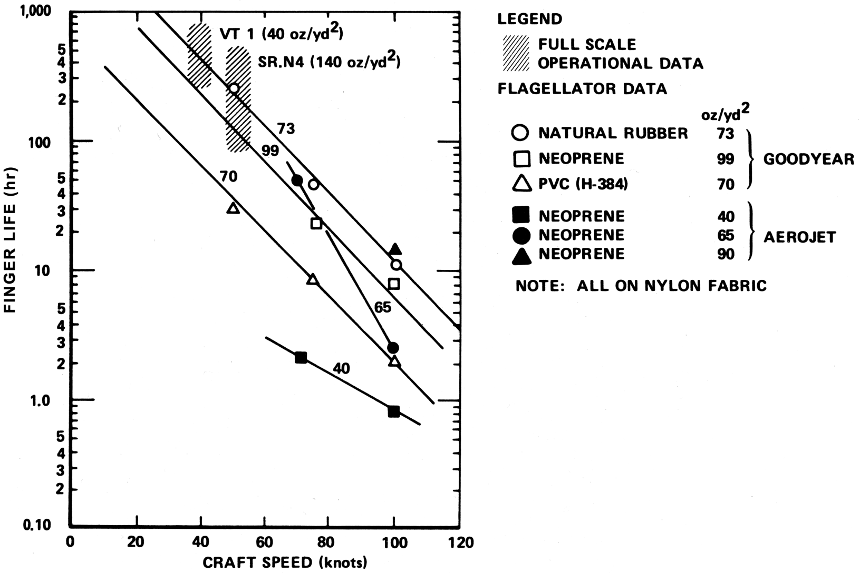
Air cushion craft skirt life
Peter J. Mantle, Air Cushion Craft Development (First Revision), DTNSRDC-80/012 (Bethesda: D.W. Taylor Naval Ship R&D Center, 1980), p. 249.

Slide 13
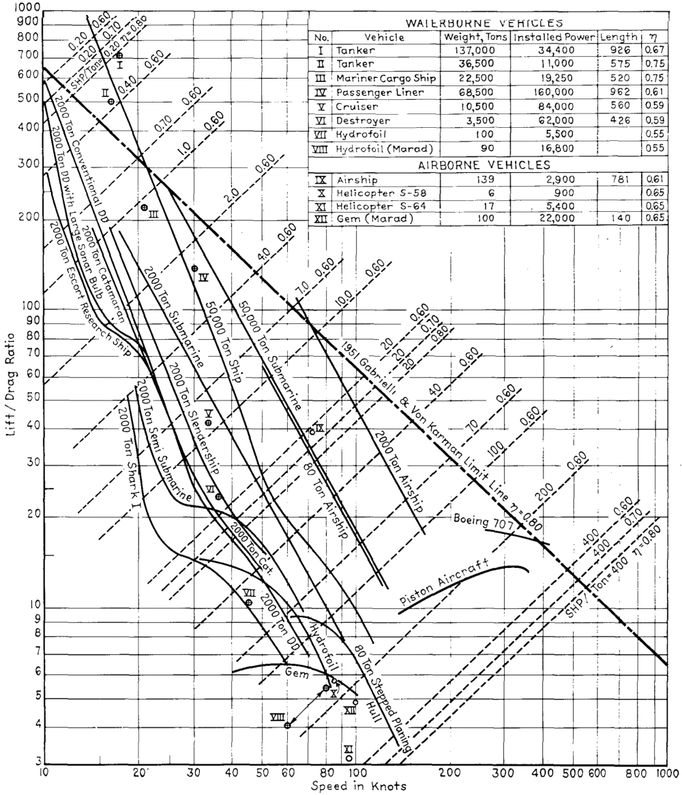
Vehicle performance (1962)
Philip Mandel, “A Comparative Evaluation of Novel Ship Types,” Transactions, SNAME 70 (1962): 128-91, p. 132.

Slide 14
Weight
Weights extremely critical in many vehicles — esp. aircraft
Parametric estimates universal in vehicles up to ~CDR
WERs very much like CERs
Parametric weights go back to early 20th century (if not before)
Often allow a system-level growth factor
Attempts to dictate weight usually end very badly — doesn’t stop people from trying
Design models do not directly accommodate weight (or cost) as an independent parameter

Slide 15
The broader context
Historical methods can help the modern designer in five main areas, though there is considerable overlap between them.
Design policy and decision—their successes and failures.
Teaching and training, by examples from the past.
Lessons and disasters, including damage in war.
Testing new theories against records of past events.
Avoiding the repetition of mistakes
— D. K. Brown, RCNC, “History as a Design Tool,” Journal of Naval Engineering 34, no. 1 (1992): 40-56.

Slide 16
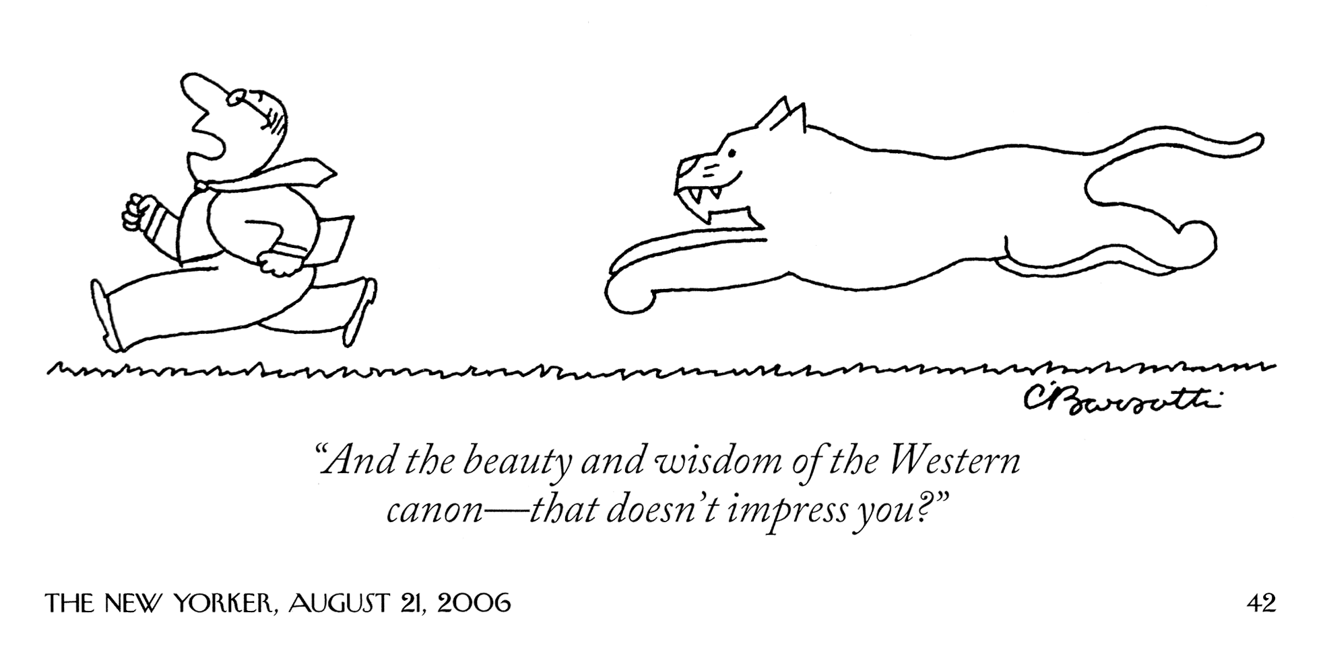
Theory cannot eliminate need for parametric analysis

